Slide 1


Exeter Age-depth modelling
For peatlands
Session 1
Radiocarbon dating and calibration

Slide 2
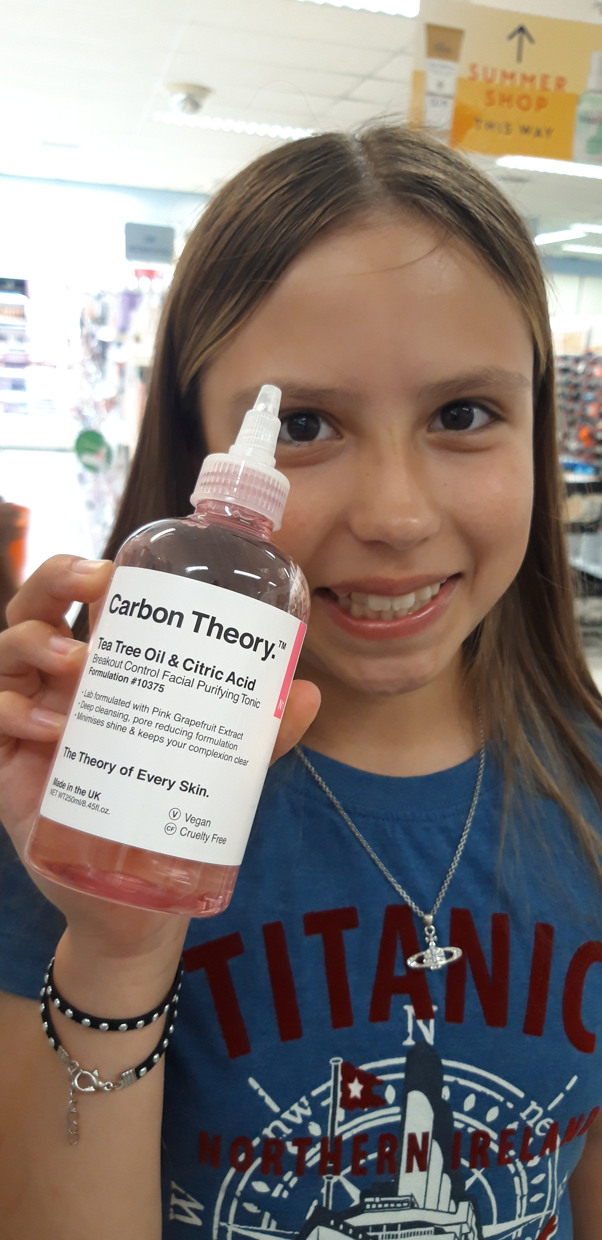
Schedule
Radiocarbon theory
Age-depth model theory
Age-depth practical
13:00 – 17:00

Slide 3
Schedule
Mixing Powerpoint slides with R code
Keep R open, try to run the blue R code on your own computer
Speak up when things go wrong!

Slide 4
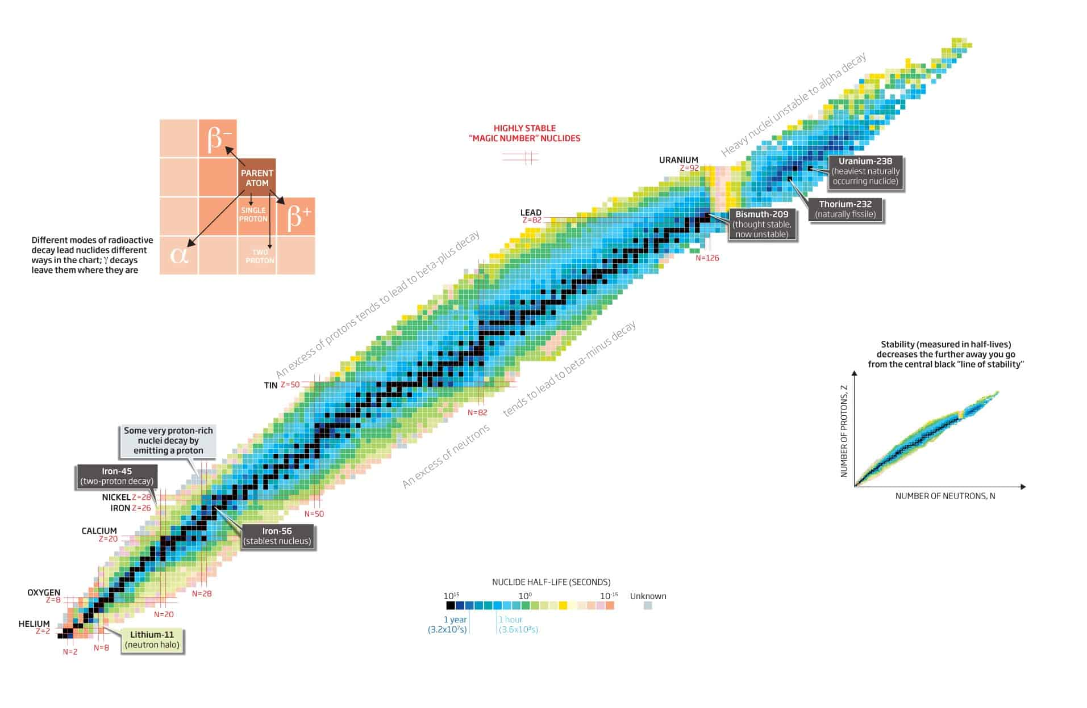
https://www.nuclear-power.com/nuclear-power/reactor-physics/atomic-nuclear-physics/nuclear-stability/

Slide 5
Radioactive decay
Decay rates are constant as far as we know
Not influenced by environment
Average lifespan ¹⁴C 8600 years – half-life 5730
100% at t=0 (AD 1950)

Slide 6
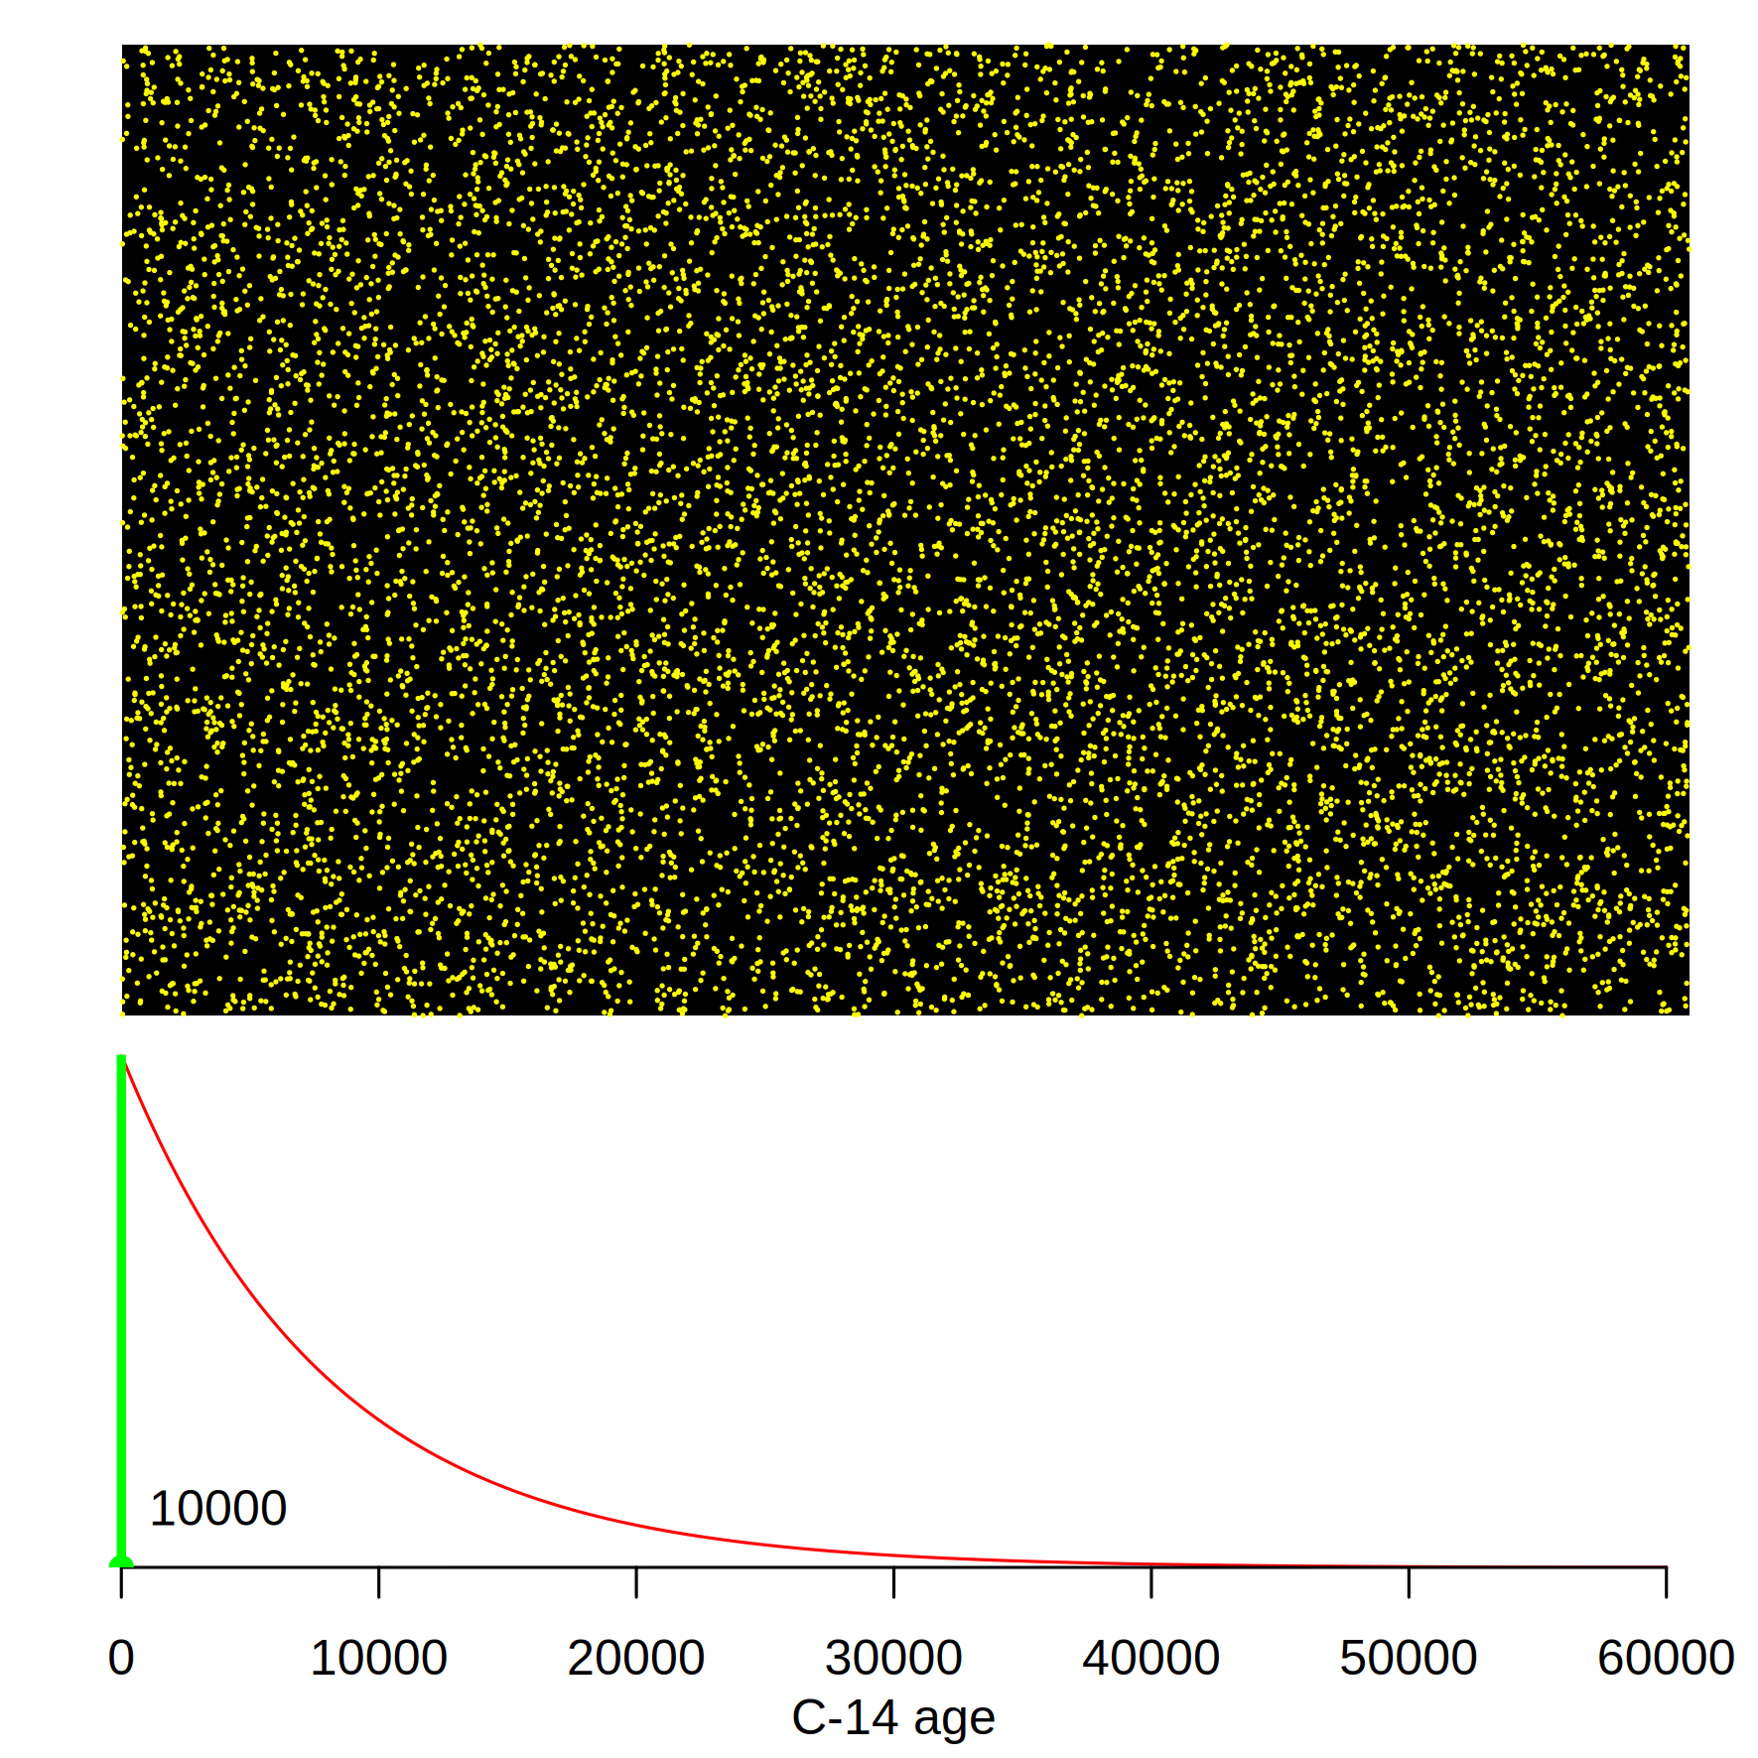
https://maarten14c.github.io/

Slide 7
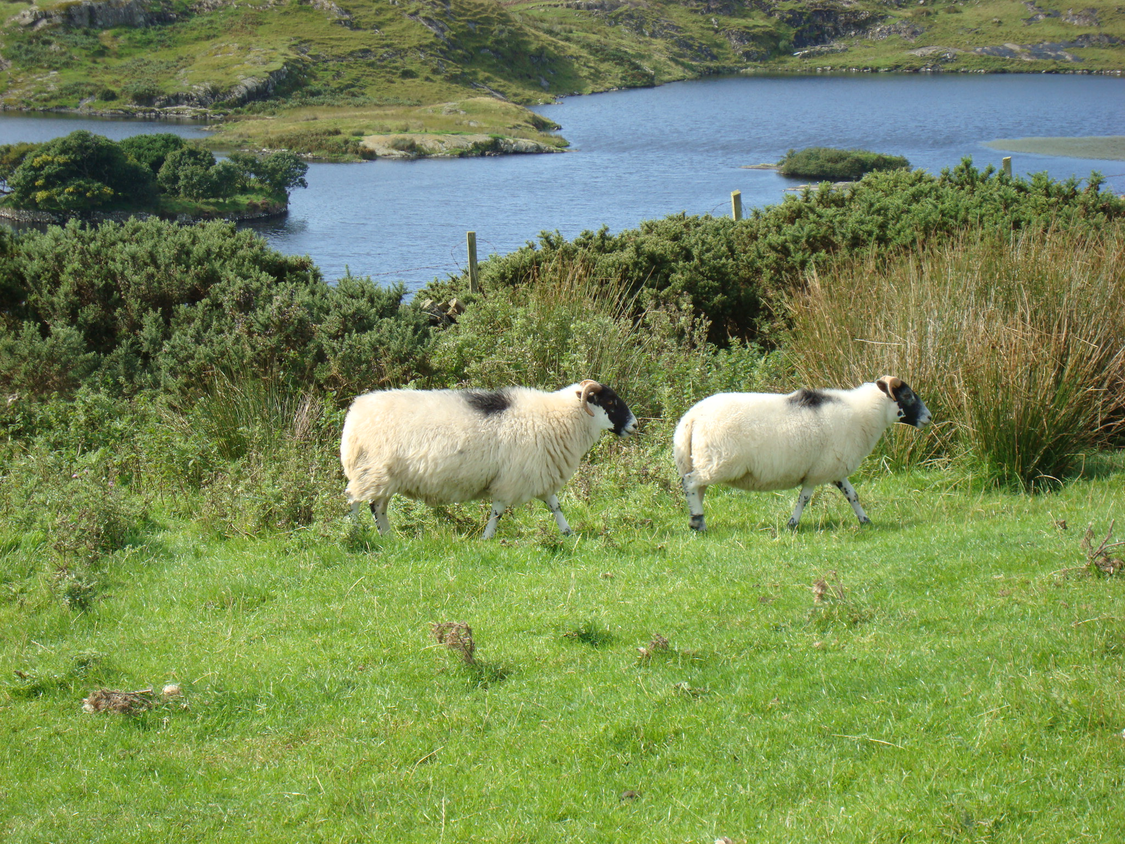
Cosmic rays
¹⁴N + n
¹⁴C + O₂
¹⁴C + p
¹²CO₂
¹⁴CO₂
¹³CO₂
¹⁴C/¹²C
Notes:
14C production
Exchange with reservoirs

Slide 8
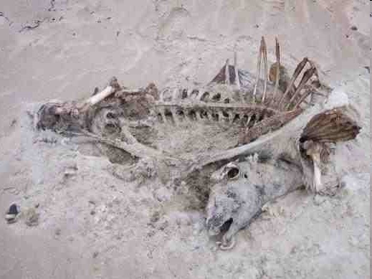
Cosmic rays
¹⁴N + n
¹⁴C + O₂
¹⁴C + p
¹²CO₂
¹⁴CO₂
¹³CO₂
¹⁴C/¹²C
Notes:
14C production
Exchange with reservoirs

Slide 9
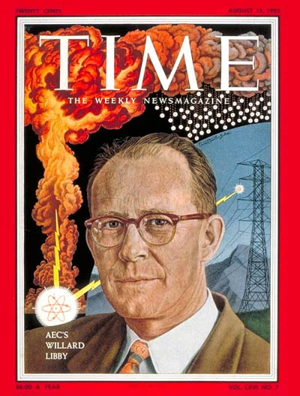
Libby’s ¹⁴C decay counter

Slide 10
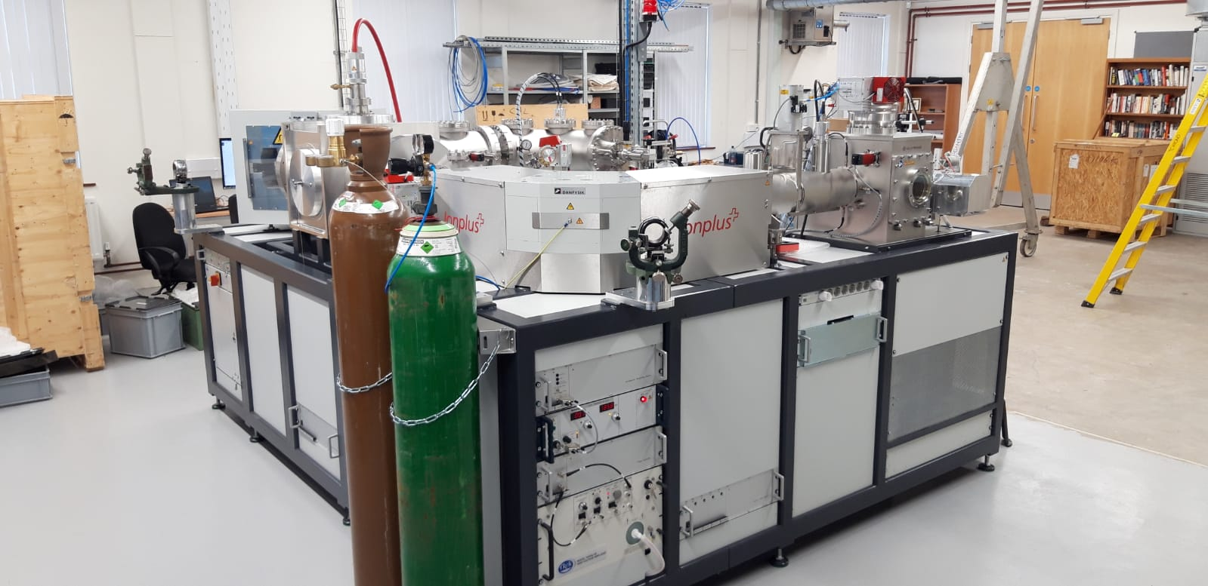
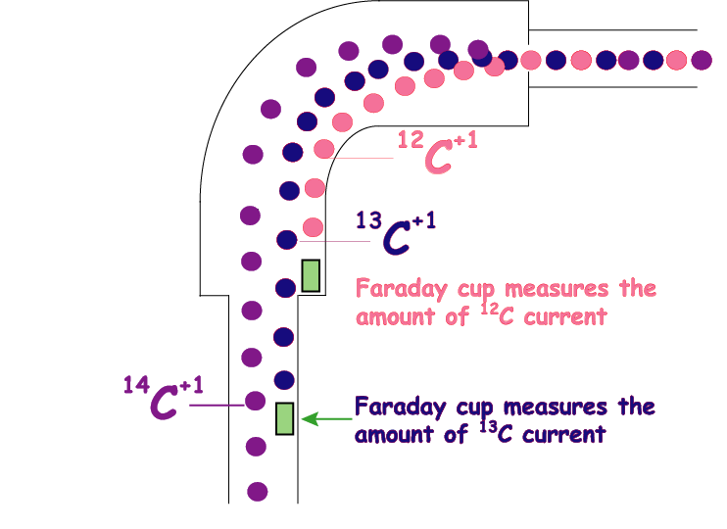

Slide 11
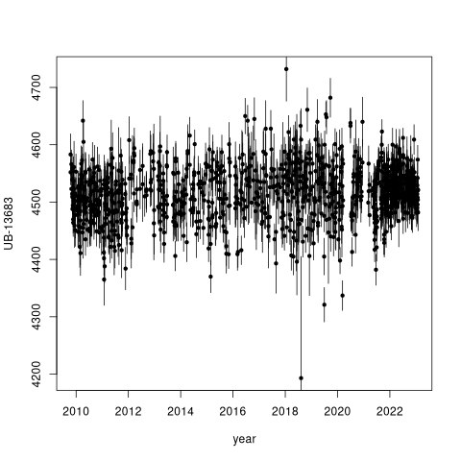
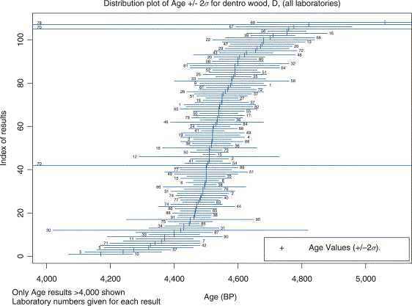
Scott, 2013 (Encycl. Quat. Sci.)
Notes:
29

Slide 12
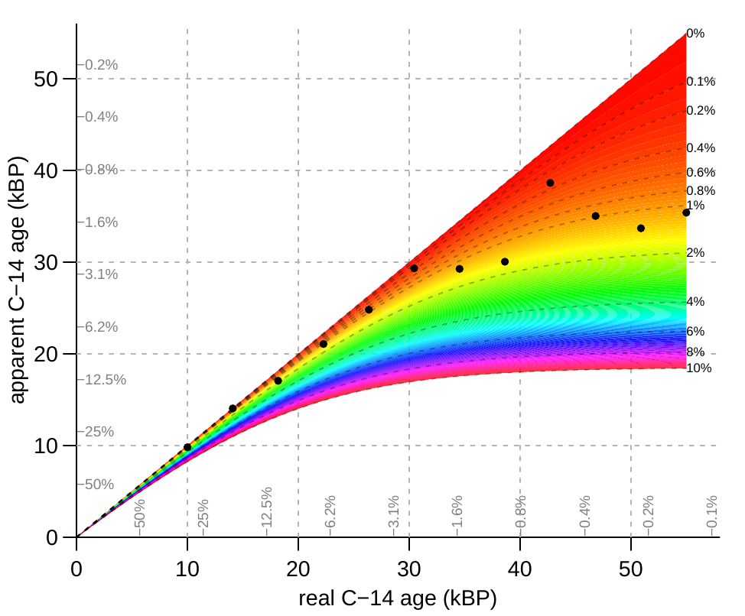
F = 0.5^(¹⁴C age/5573)
F_{obs} = c*F_{c} + (1-c)*F_{real}
F_{c}=1 recent contamination
install.packages(‘rintcal’)
require(rintcal)
draw.contamination()
https://cloud.r-project.org/web/packages/rintcal/vignettes/calculations.html

Slide 13
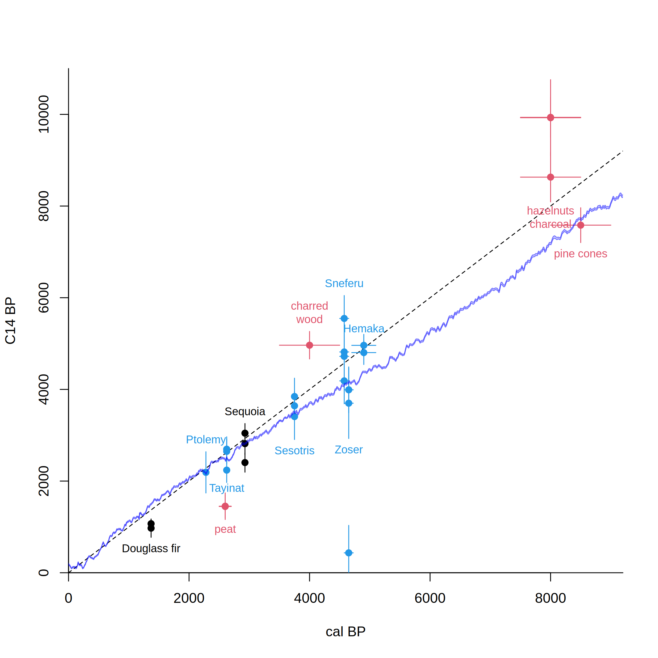
Libby’s Curve of Knowns vs IntCal20
After Arnold & Libby 1951
Science 113, 111-150
Notes:
29

Slide 14
Radiocarbon calibration
CALIBRATION: verification that the method is accurate
Chunks of wood representing 10-20 years were taken from tree-ring dated US trees, and the ¹⁴C in them was measured
The exact age of each tree ring was known
This gave a continuous record of atmospheric ¹⁴C
Confirmed in European labs

Slide 15
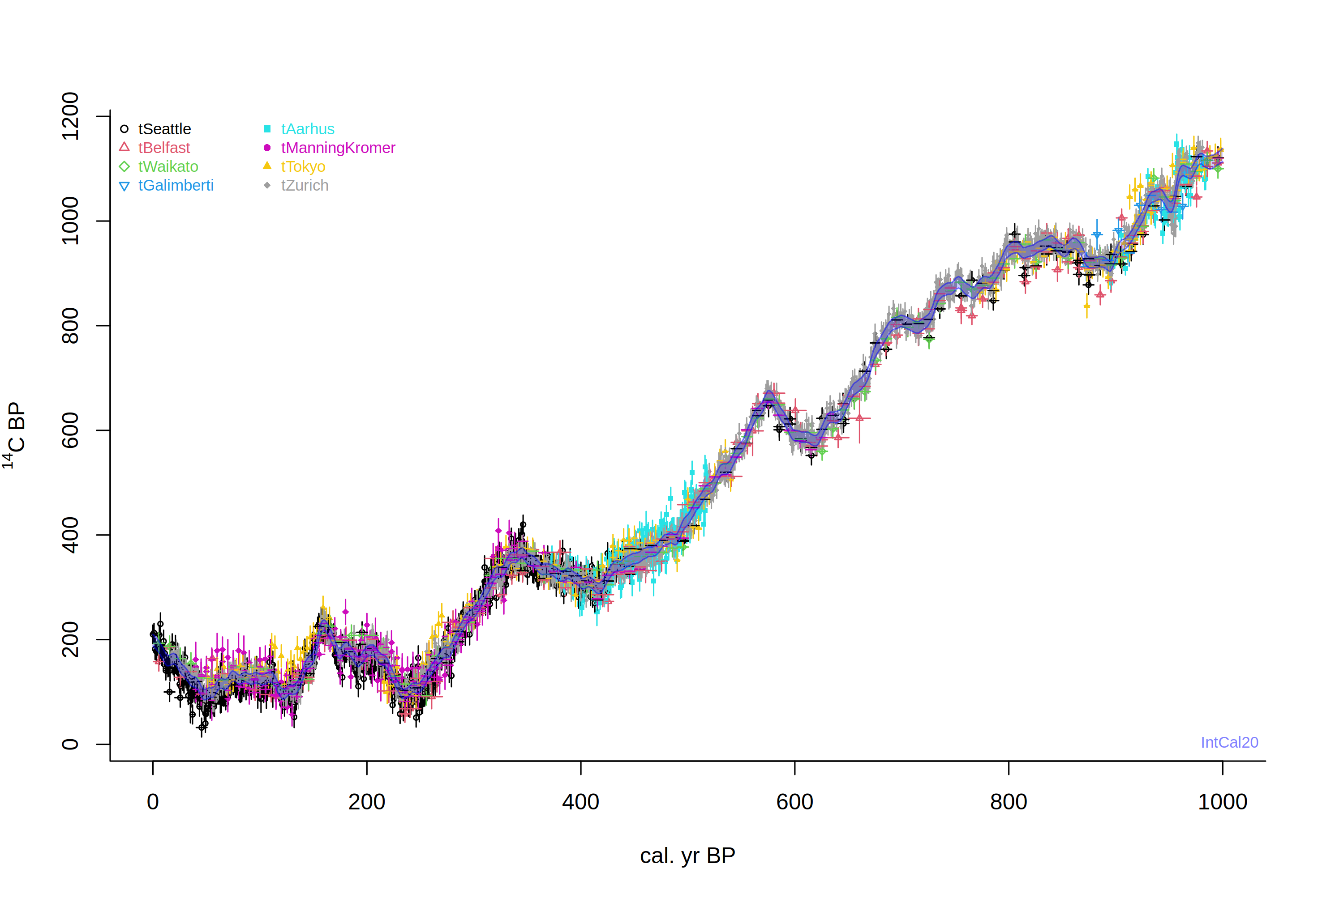
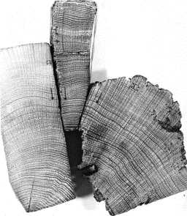
install.packages(‘rintcal’)
require(rintcal)
intcal.data(0, 1000)

Slide 16
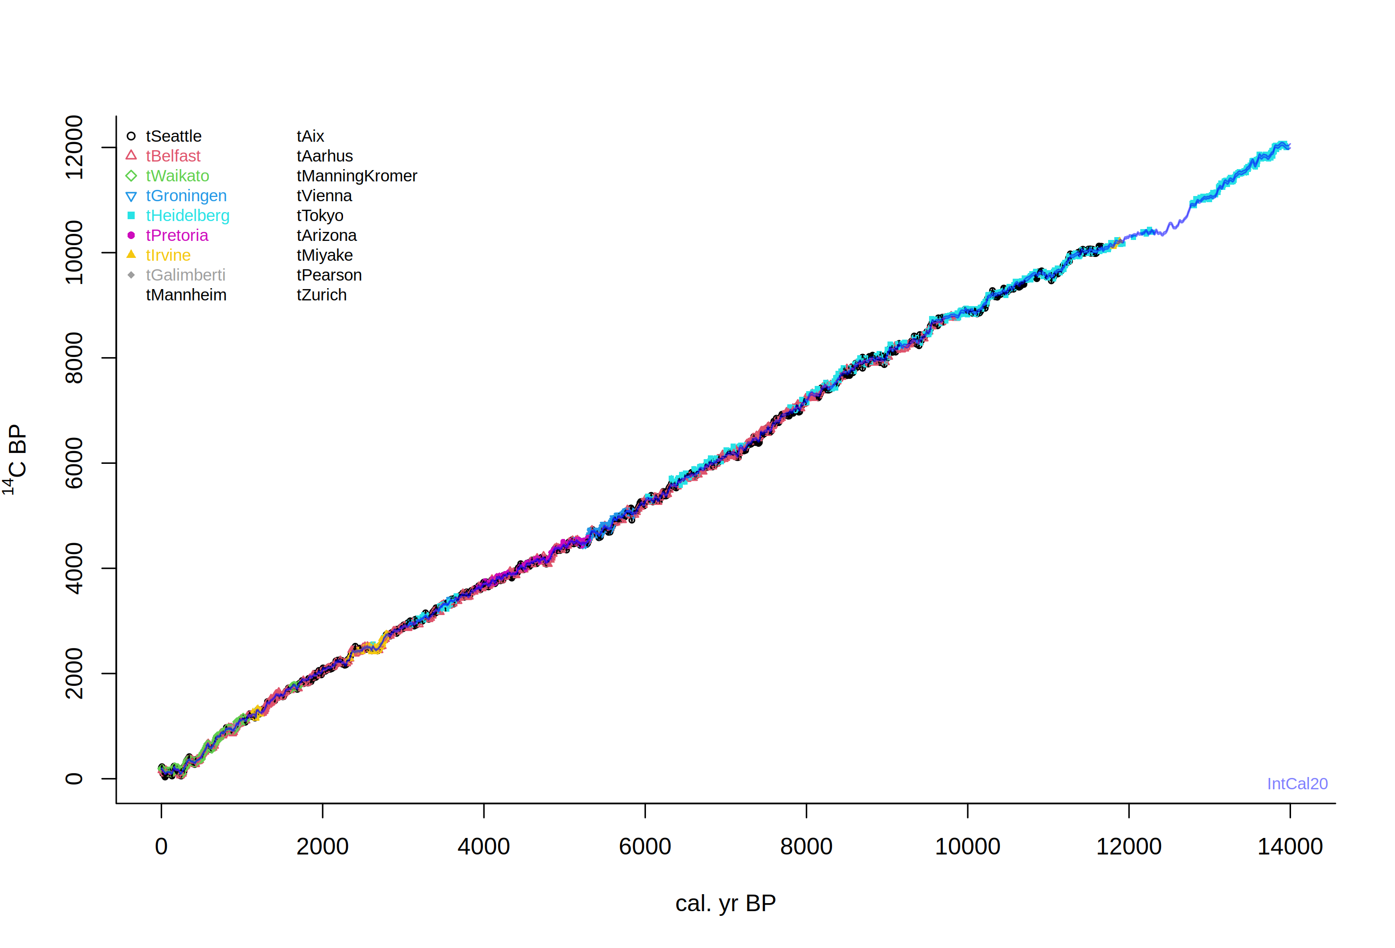

Slide 17
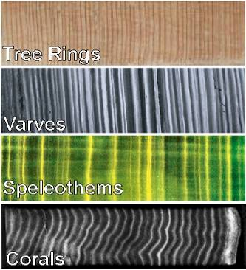
Extension of the ¹⁴C calibration curve
More tree rings (floating)
Varves (marine or lacustrine)
Speleothems
Corals

Slide 18
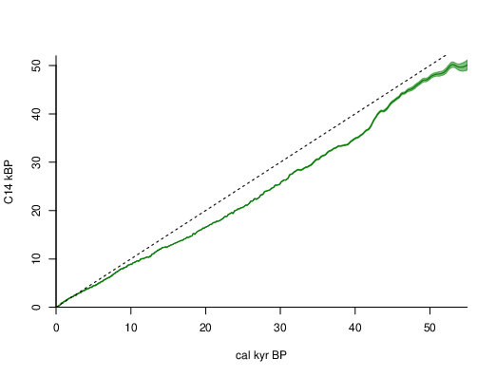
IntCal20
draw.ccurve(ka=TRUE)
Reimer et al. 2020

Slide 19
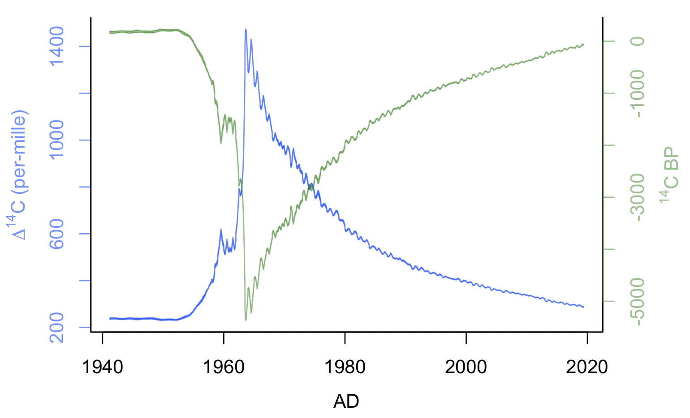
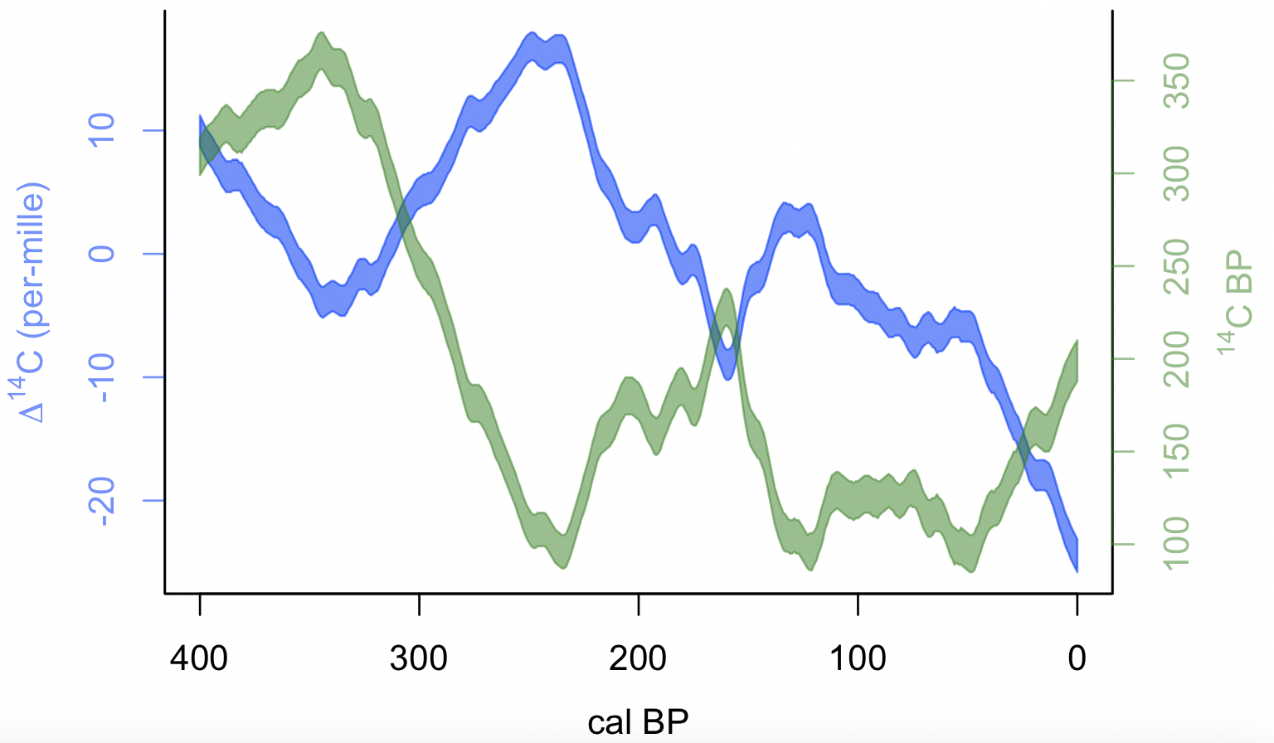
Recent changes of ¹⁴C in the atmosphere
anthropogenic activity (burning of fossil fuels, bomb tests): release of ‘old’ or ‘new’ carbon
draw.D14C(cc=ccurve("NH1_monthly"), BCAD=TRUE, cal.lab="AD")
draw.D14C(400, 0, cal.rev=TRUE)
Notes:
<number>
de Vries found that 17-th century wood had a 2% higher activity than 19th century wood.

Slide 20
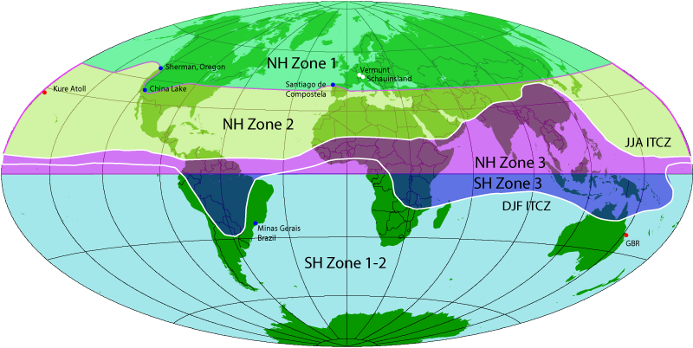
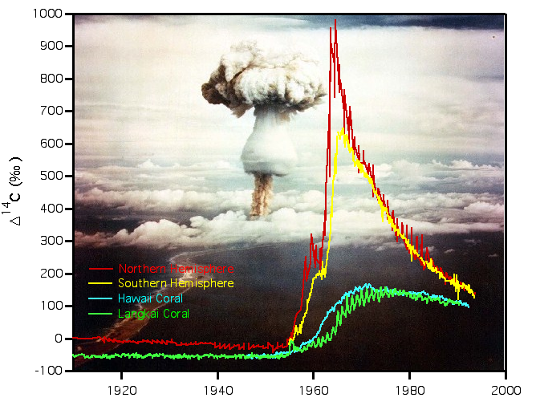
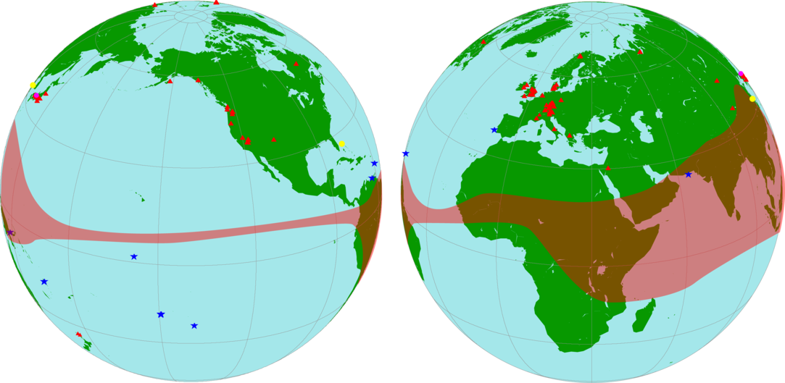
http://calib.org/CALIBomb/
Courtesy Stewart Fallon, LLNL
Reimer et al. 2020 Radiocarbon
Notes:
<number>

Slide 21
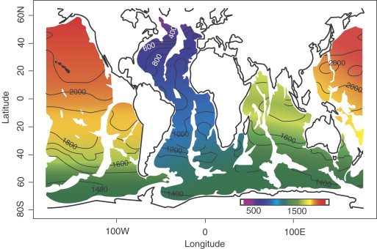
Hughen 2007, Developments in Marine Geology

Slide 22
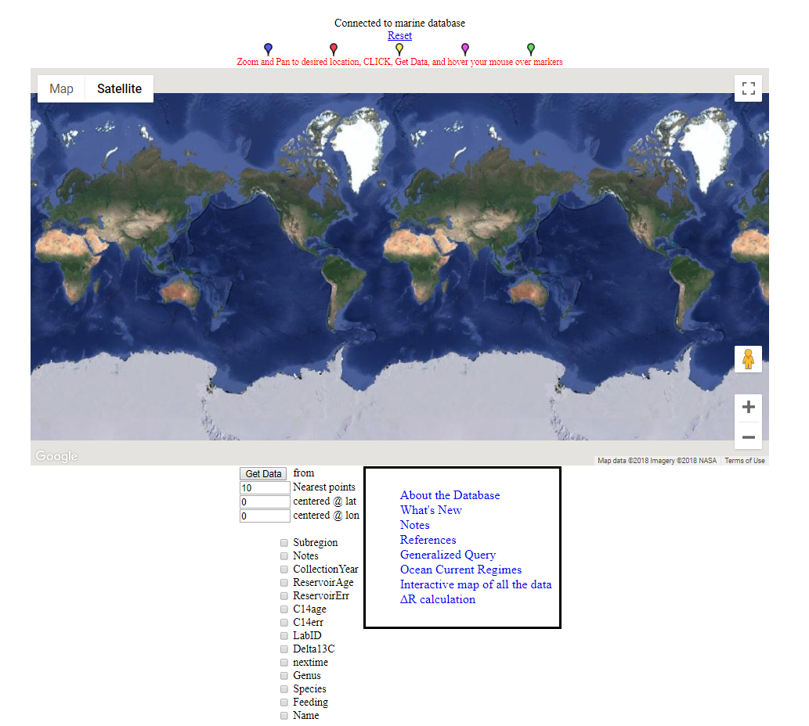
Marine Reservoir Correction Database
http://calib.org/marine/

Slide 23
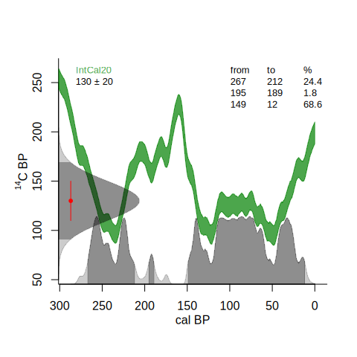
¹⁴C calibration
calibrate()
Notes:
<number>

Slide 24
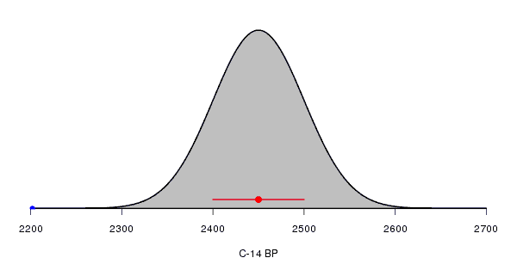
¹⁴C calibration
Each radiocarbon date comes with a lab error
Assumed to be distributed normally/Gaussian
Or alternatively, a student-t distribution with longer tails
Notes:
<number>

Slide 25
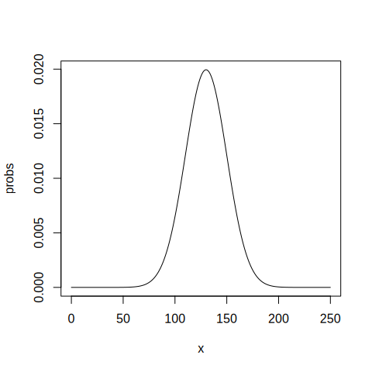
¹⁴C calibration
dnorm(125, 130, 20)
dnorm(130, 130, 20)
x <- 0:250
probs <- dnorm(x, 130, 20)
head(cbind(x, probs))
sum(probs)
plot(x, probs, type="l")
Notes:
<number>

Slide 26
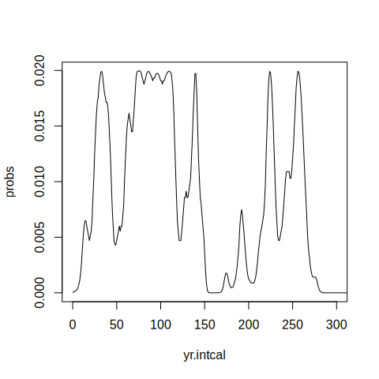
¹⁴C calibration
cc <- ccurve()
head(cc)
yr.intcal <- cc[,1]
c14.intcal <- cc[,2]
probs <- dnorm(c14.intcal, 130, 20)
plot(yr.intcal, probs, xlim=c(0, 300), type="l")
Notes:
<number>

Slide 27
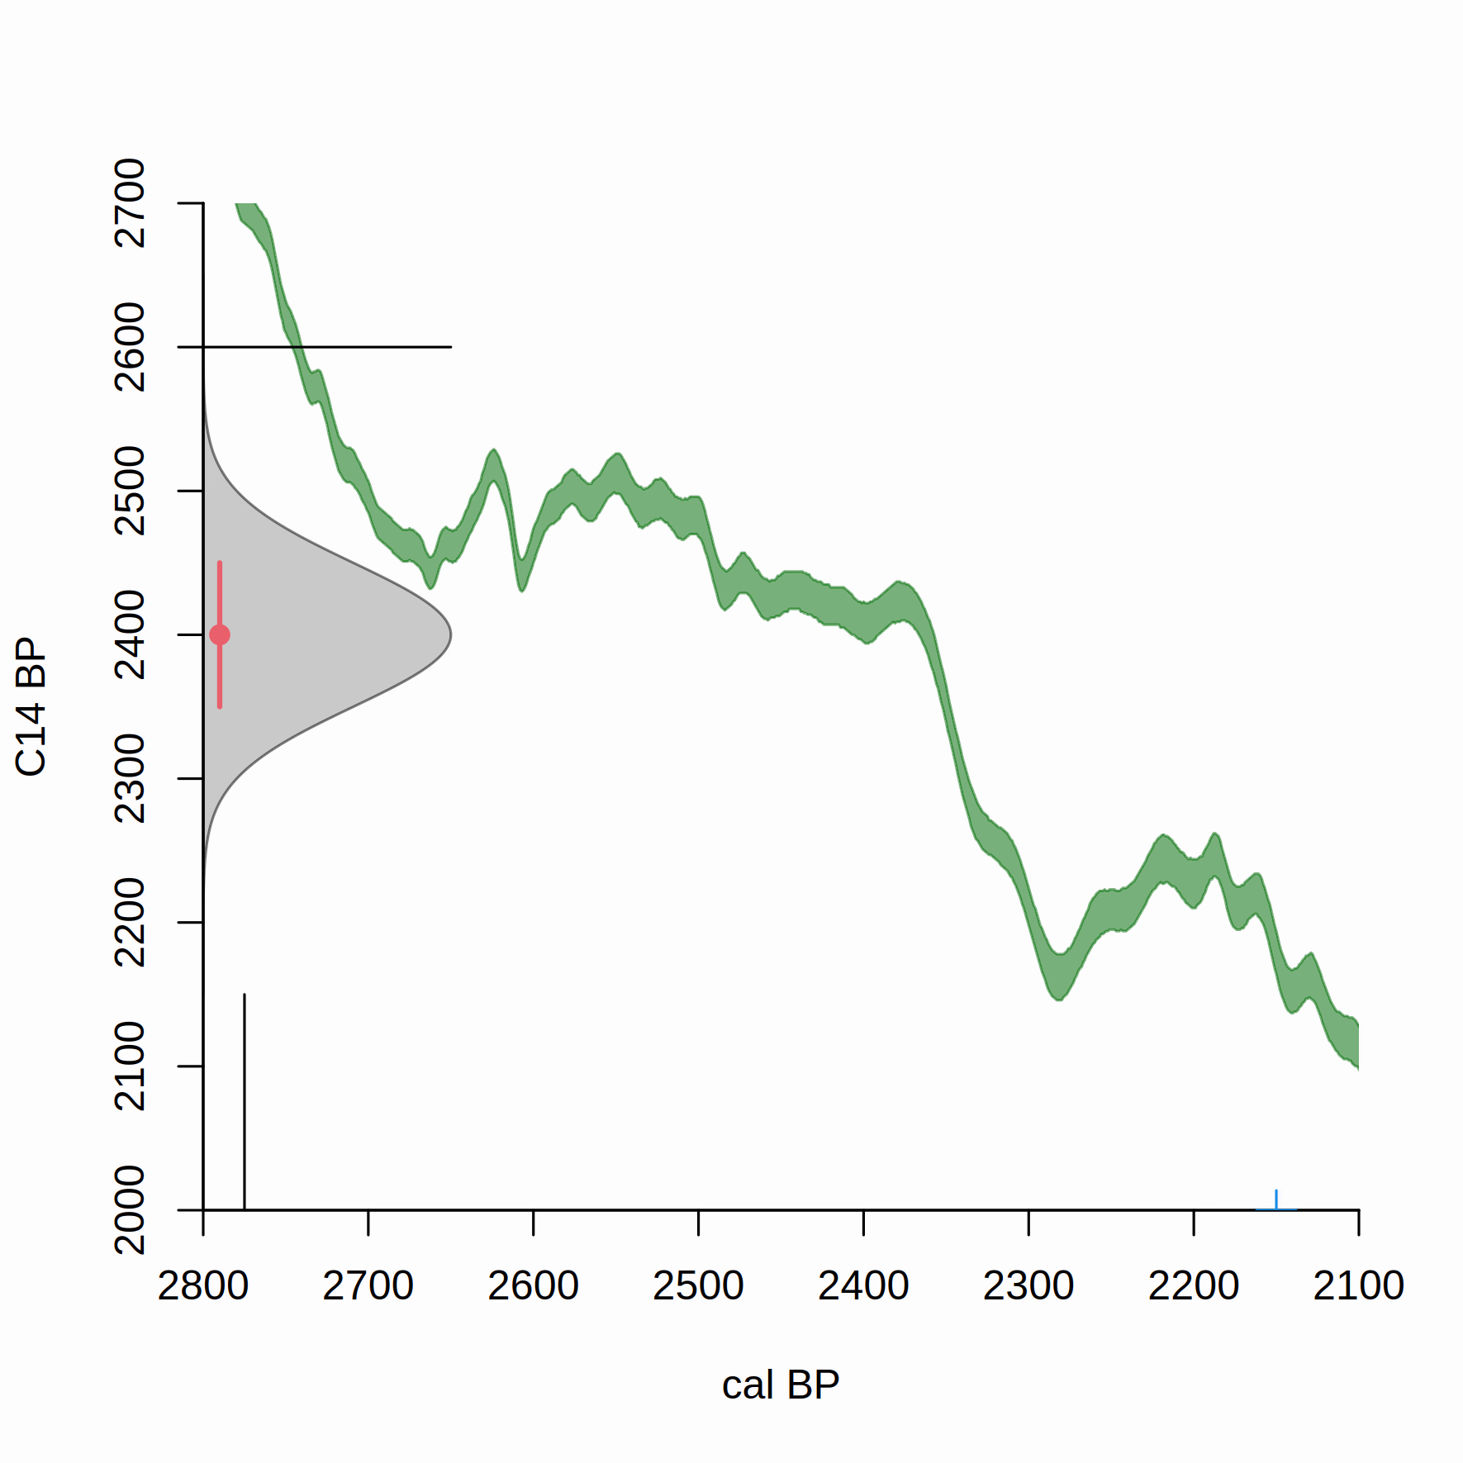
https://vimeo.com/603317968

Slide 28
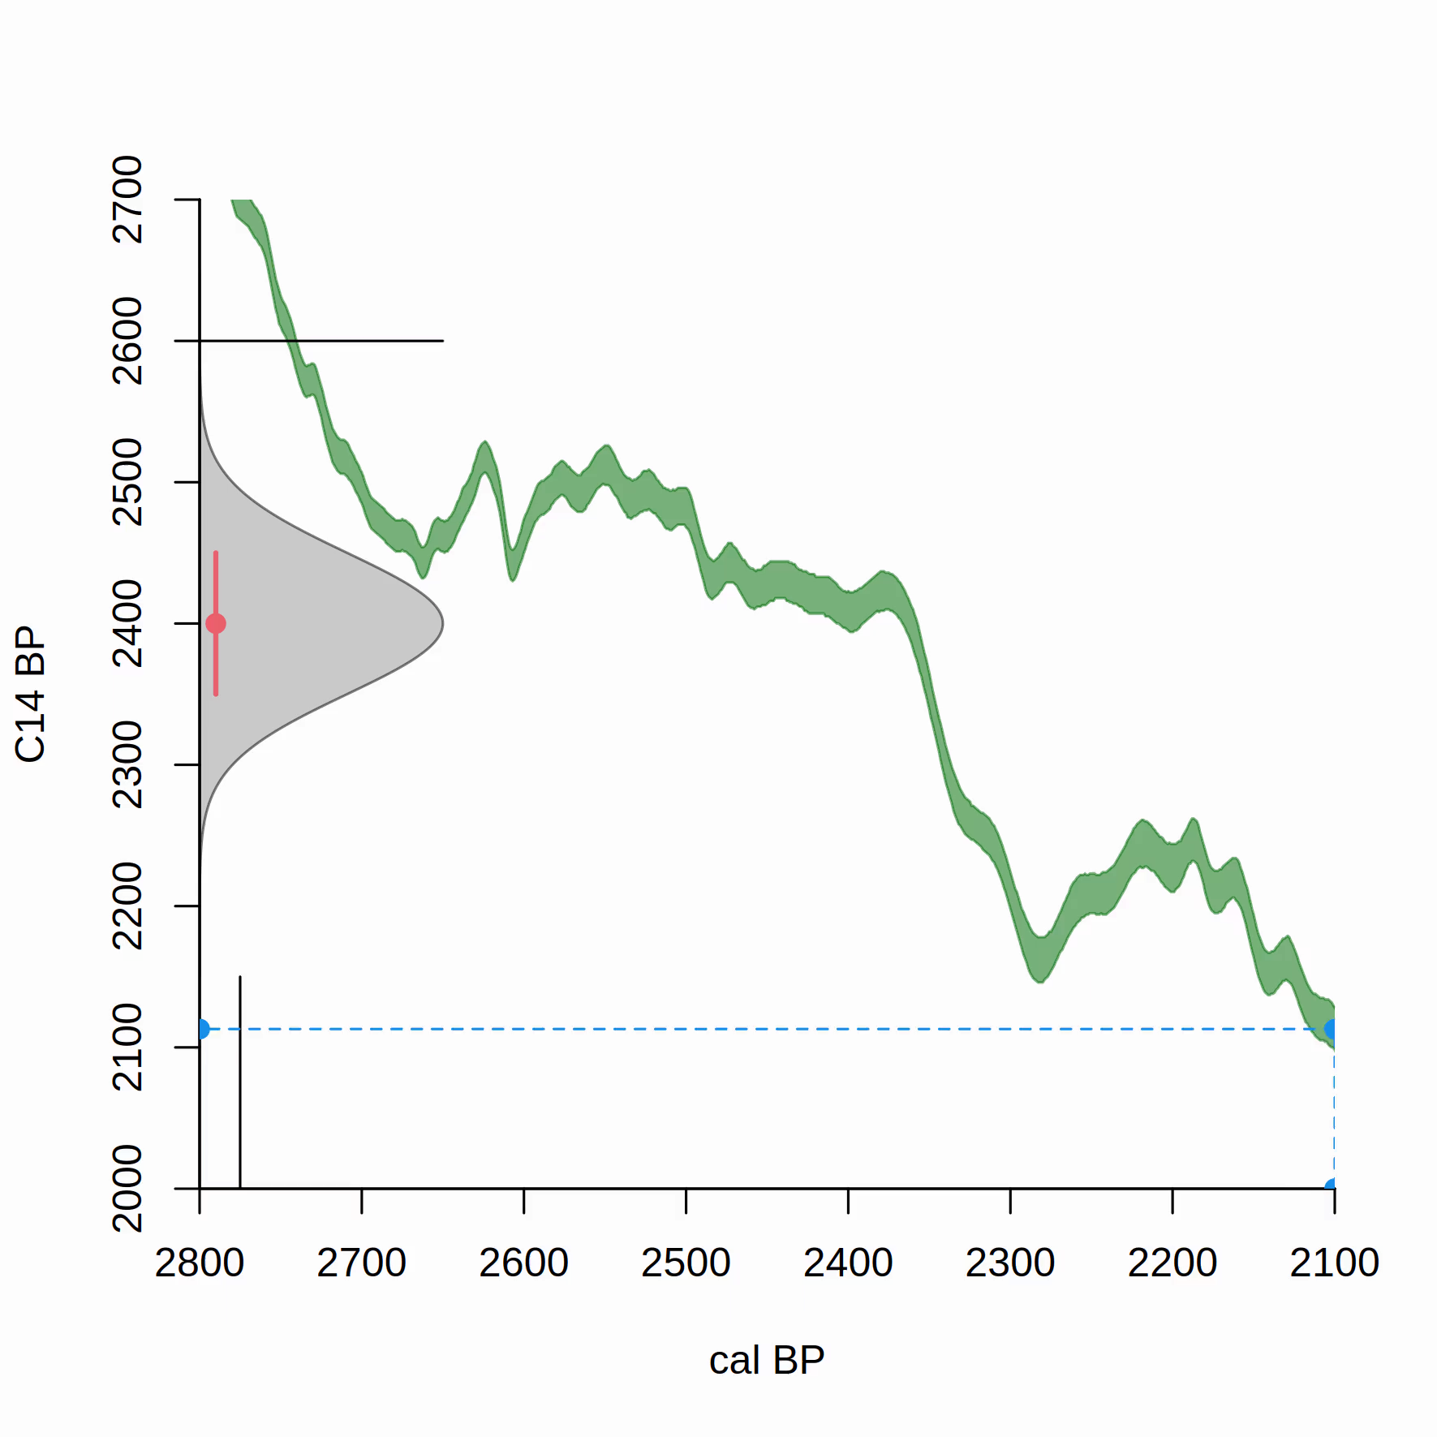
https://vimeo.com/603364618

Slide 29
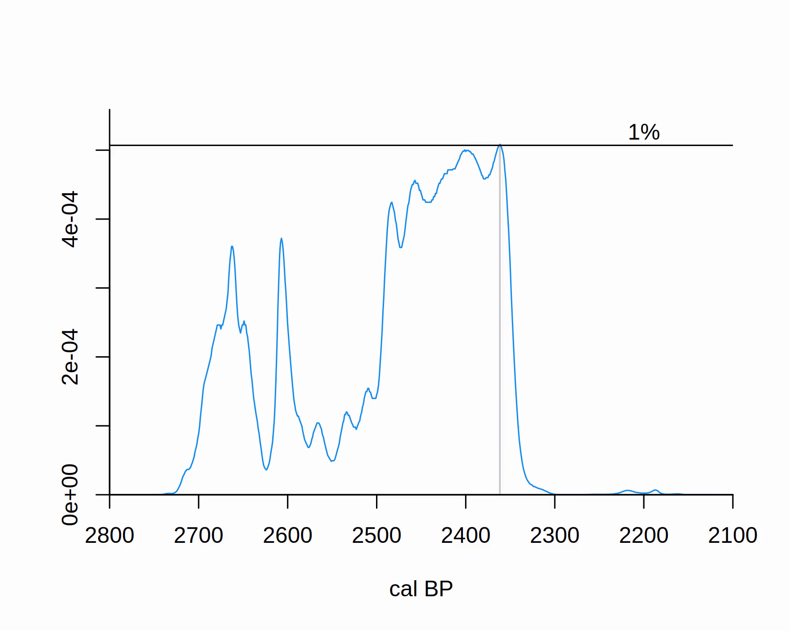
¹⁴C calibration – hpd ranges
https://vimeo.com/603420882
Notes:
<number>

Slide 30
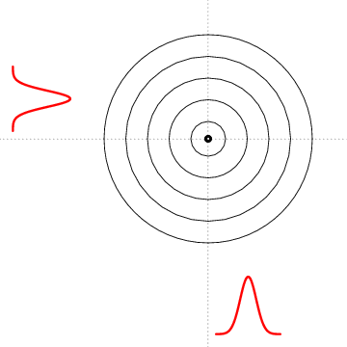
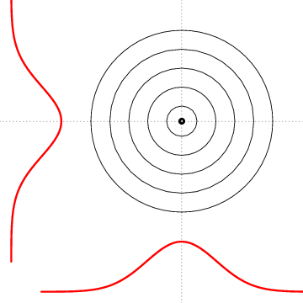
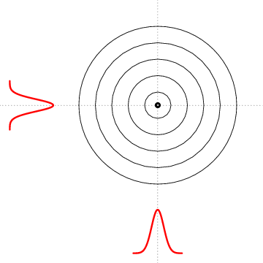
Notes:
<number>

Slide 31
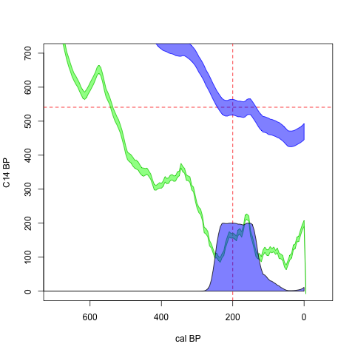
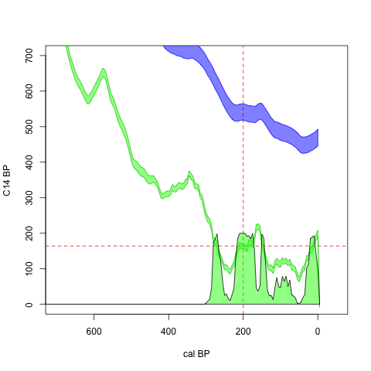

Slide 33
